Slide 1

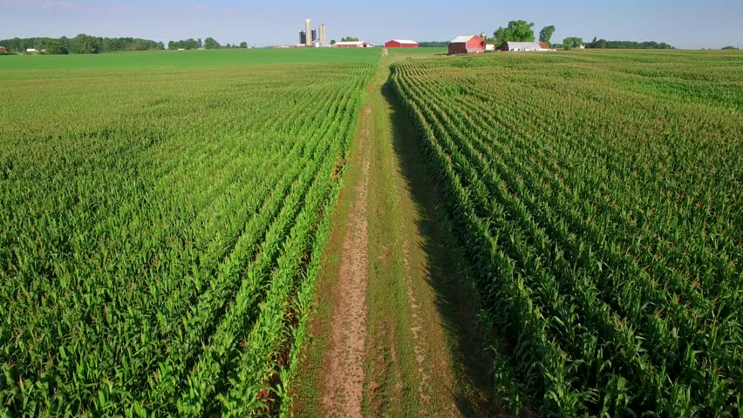
SRM Institute of Science and Technology School of Computing
Department of Computational Intelligence Kattankulathur
Multisensor Crop Guidance REALTIME Engine With Cloud Analytics And Recommendation System

Slide 2
OUR TEAM
NAME | REG. NO.
Achal Kamboj | RA2011026010028
Anurag Malik | RA2011026010030
Anmol Agarwal | RA2011026010034
Jaiaditiya Ghorpade | RA2011026010035
Under the Guidance of :
Dr. SUMATHY G Assistant Professor, Department of Computational Intelligence SRM Institute of science and Technology, Kattankullathur

Slide 3
Table Of Content
Project Title
Abstract
Introduction
Motivation
Literature Survey
Research Gaps
Problem Statement
Challenges and Limitations in existing system
Objectives
Innovation
Scope of Project
Architecture Diagram
Proposed Modules
UML Diagram
Conclusion
References

Slide 4
ABSTRACT
The Multisensory Crop Guidance REALTIME Engine (MCG-RE) marks a groundbreaking leap in agriculture. Imagine a system that seamlessly blends the sensors, Cloud Analytics and an advanced Recommendation System to revolutionize how we manage crops. This autonomous marvel operates in real-time, revolutionizing crop management by optimizing water use through an Automatic Irrigation System triggered by moisture sensor readings. But it doesn't stop there. The MCG-RE goes further with Nutrient Monitoring and Dosing, powered by NPK sensors. This means a product made nutrient supply that boosts crop health and maximizes yield. Environmental Monitoring takes the reins with adaptive strategies based on real-time analysis, ensuring that crops thrive under the best possible conditions. Picture this: Soil and Water pH Monitoring keeping tabs on optimal conditions. The MCG-RE doesn't just gather data; it transforms it into actionable insights for farmers through a user-friendly Cloud Analytics interface and a Recommendation System fueled by machine learning. It's like having a personal agricultural advisor at your fingertips. In essence, the MCG-RE is the epitome of precision agriculture. It doesn't just meet but surpasses global sustainability goals, reshaping farming practices to be more efficient and resilient. It's a game-changer, bringing the future of farming into the present.

Slide 5
INTRODUCTION
The Multisensory Crop Guidance REALTIME Engine (MCG-RE) revolutionizes agriculture through latest technology. With an Automatic Irrigation System triggered by moisture sensors and NPK-powered Nutrient Monitoring, it optimizes water usage and enhances crop health. Environmental Monitoring and Cloud Analytics provide real-time insights, while the Recommendation System empowers farmers with personalized guidance, embodying a holistic precision agriculture solution for sustainable and resilient farming.

Slide 6
MOTIVATION
The MCG-RE addresses inefficiencies, resource wastage and unpredictable environmental factors inherent in traditional farming, prompting a shift towards sustainable and technology-driven approaches.
Motivated by the growing demand for food production due to global population growth, the project aims to enhance agricultural productivity while minimizing environmental impact through advanced sensors and automation. Driven by a commitment to sustainability, the project incorporates Soil/Water pH Monitoring and personalized recommendations to contribute to resource conservation. This includes reducing water usage and minimizing the environmental footprint of agriculture.
By merging technological innovation with a commitment to sustainability, the MCG-RE aims to empower farmers with precise, data-driven insights and automated solutions. The project endeavors to enhance food security and contribute to a resilient and efficient global agricultural landscape.

Slide 7
Literature Survey
Author’s Name | Jonural Name | Title | Year | Methodology | Inference
A. Reyana, Sandeep Kautish, P. M. Sharan Karthik, Ibrahim Ahmed Al-Baltah, Muhammed Basheer Jasser and Ali Wagdy Mohamed | IEEE ACCESS | Accelerating Crop Yield: Multisensor Data Fusion and Machine Learning for Agriculture Text Classification | 2023 | The study employs a Multisensor Machine-Learning Approach for classifying multisensor data. This approach supports high-quality data analysis in agricultural contexts, providing cultivation recommendations based on the classification of eight different crops. | The Random Forest algorithm demonstrates effectiveness in classifying agriculture text, leading to enhanced precision in crop yield predictions. This approach contributes to a significant increase in crop yield and promotes awareness in condition-based environmental monitoring systems.
Rishi Gupta; Akhilesh Kumar Sharma; Oorja Garg; Krishna Modi; Shahreen Kasim; Zirawani Baharum | IEEE ACCESS | WB-CPI: Weather Based Crop Prediction in India Using Big Data Analytics | 2021 | The study aims to enhance crop production by leveraging weather data, including temperature, rainfall, soil conditions, seed type, humidity and wind speed. Initially, the data is pre-processed in a Python environment. Next, the MapReduce framework is applied to analyze and process the large volume of data. K-means clustering is then employed to improve accuracy. | The WB-CPI system provides valuable insights for farmers, aiding them in making informed decisions about crop selection based on weather conditions. By integrating big data analytics, it contributes to sustainable agriculture practices and improved crop yields.

Slide 8
Literature Surey
Author’s Name | Jonural Name | Title | Year | Methodology | Inference
Arfat Ahmad Khan, Muhammad Faheem, Rab Nawaz Bashir, Chitapong Wechtaisong and Muhammad Zaihid Abbas | IEEE ACCESS | Internet of Things (IoT) Assisted Context Aware Fertilizer Recommendation | 2022 | The authors proposed a machine learning-based fertilizer recommendation system. It uses real-time soil fertility context captured through IoT-assisted soil fertility mapping. The system uses Logistic Regression (LR), Support Vector Machine (SVM), Gaussian Naïve Bayes (GNB) and K-Nearest Neighbour (KNN) machine learning models | The system was implemented in real crop fields. The accuracy of IoT-assisted fertility mapping was assessed by comparing it with the standard soil chemical analysis method. The GNB model was found to be more accurate compared to other machine learning models evaluated, with accuracies of 96% and 94% from training and testing datasets, respectively
Md. Najmul Mowla, Neazmul Mowla, A. F. M. Shahen Shah, Khaled M. Rabie and Thokozani Shongwe | IEEE ACCESS | Internet of Things and Wireless Sensor Networks for Smart Agriculture Applications: A Survey | 2023 | The study provides a comprehensive, future-oriented approach, delving into IoT-WSNs, wireless network protocols and their applications in agriculture since 2019. It thoroughly discusses the overview of IoT and WSNs, encompassing their architectures and summarization of network protocols | The study addresses recent issues and challenges related to IoT-WSNs and proposes mitigation strategies. It emphasizes the integration of advanced technology aiming to contribute to the future development of smart agriculture systems¹. The integration of IoT and WSNs is crucial in enhancing food production across various agricultural domains

Slide 9
Literature Survey
Author’s Name | Jonural Name | Title | Volume/Issue No. and Year | Methodology | Inference
G. Garg, S. Gupta, P. Mishra, A. Vidyarthi, A. Singh and A. Ali | IEEE IOT JOURNAL | CROPCARE: An Intelligent Real-Time Sustainable IoT System for Crop Disease Detection Using Mobile Vision | 2023 | The paper introduces CROPCARE, a sustainable real-time system for crop disease detection and prevention. The system integrates mobile vision, Internet of Things (IoT) and Google Cloud services. The primary function of this intelligent system is to detect crop diseases through the CROPCARE mobile application. | CROPCARE offers a powerful solution for real-time crop disease detection, leveraging cutting-edge technologies. By combining mobile vision, IoT and cloud services, it contributes to sustainable agriculture practices, aiding farmers in making informed decisions and preventing crop losses.
C. Jamroen, P. Komkum, C. Fongkerd and W. Krongpha | IEEE ACCESS | An Intelligent Irrigation Scheduling System Using Low-Cost Wireless Sensor Network Toward Sustainable and Precision Agriculture | 2020 | The paper proposes an intelligent irrigation scheduling system that utilizes a low-cost wireless sensor network (WSN). The system employs fuzzy logic to adaptively schedule irrigations, considering crop and soil water variabilities. Two critical variables are incorporated: Crop Water Stress Index (CWSI): Calculated using canopy temperature, solar irradiation and vapor pressure deficit, this index indicates plant water status. | The proposed system significantly reduces water usage by 59.61% and electrical energy consumption by 67.35%, while increasing crop yield by 22.58%. It effectively achieves precision irrigation scheduling and demonstrates efficiency in terms of water use and energy consumption.

Slide 10
Literature Survey
Author’s Name | Jonural Name | Title | Year | Methodology | Inference
O. O. Ajayi, A. B. Bagula, H. C. Maluleke, Z. Gaffoor, N. Jovanovic and K. C. Pietersen | IEEE ACCESS | WaterNet: A Network for Monitoring and Assessing Water Quality for Drinking and Irrigation Purposes | 2022 | Water is a fundamental requirement for human, animal and plant survival. However, quality water is not always fit for drinking, domestic, or industrial use due to factors like industrialization, mining, pollution and natural occurrences. These factors introduce or alter various parameters in water, affecting its suitability. The study proposes a network architecture called WaterNet that collects real-time data on water parameters. | WaterNet offers an intelligent solution for assessing water quality. By combining real-time data collection, ML algorithms and LoRa technology, it aids in determining water suitability for both drinking and irrigation purposes. The study contributes to sustainable water management and informed decision-making.
V. Grimblatt, C. Jégo, G. Ferré and F. Rivet | IEEE Journal | How to Feed a Growing Population—An IoT Approach to Crop Health and Growth | 2021 | The paper addresses the challenge of feeding a growing global population while respecting the planet’s resources. With an estimated 9.2 billion human beings by 2050, annual resource consumption is projected to be nearly twice what the Earth can provide. To meet this demand, crop production must increase by 70%. | By integrating IoT, affordable sensors and ADMS, this approach contributes to sustainable agriculture. It empowers small to medium farmers to enhance productivity while safeguarding the planet’s resources

Slide 11
Literature Survey
Author’s Name | Jonural Name | Title | Year | Methodology | Inference
Y. Teng, X. Chen, Z. Yu and J. Wei | IEEE ACCESS | Research on the Evolutionary Decision-Making Behavior Among the Government, Farmers and Consumers: Based on the Quality and Safety of Agricultural Products | 2021 | The study investigates the interplay of decision-making behavior among three key stakeholders: government, farmers and consumers, with a focus on agricultural product quality and safety. The primary factors impacting food safety are the quality and safety of agricultural products. Farmers’ decision-making behavior is closely linked to these factors. | The evolutionary process of decision-making behavior among the three stakeholders toward an ideal state is influenced by various factors. Different factor value ranges impact the convergence speed to the ideal state.
C. Xie, Y. Zhu and Q. Zhao | IEEE ACCESS | How Digital Business Penetration Influences Farmers’ Sense of Economic Gain: The Role of Farmers’ Entrepreneurial Orientation and Market Responsiveness | 2022 | The study investigates the impact of digital business penetration (DBP) on farmers’ sense of economic gain (SEG) in traditional villages in western China. DBP refers to the extent to which farmers develop new digital business awareness due to changes in infrastructure, smartphone usage and digital ventures. The research collects questionnaire responses from 343 farmers. | The study highlights the importance of digital literacy and responsiveness in improving farmers’ entrepreneurial intention, attitude toward digitization and overall sense of economic gain. By understanding these mechanisms, policymakers and practitioners can promote sustainable economic growth in rural areas.

Slide 12
Research Gaps
S.No | Title of Research Paper | Research gaps
1 | Accelerating Crop Yield: Multisensor Data Fusion and Machine Learning for Agriculture Text Classification | The paper presents a novel Multisensor Machine-Learning Approach (MMLA) for classifying multisensor data. However, the paper only investigates the top eight classes. Future research could explore the classification of a broader range of crops
2 | WB-CPI: Weather Based Crop Prediction in India Using Big Data Analytics | The paper “WB-CPI: Weather Based Crop Prediction in India Using Big Data Analytics” presents a system for crop prediction based on weather data. However, it doesn’t discuss the system’s performance in different climatic conditions or its adaptability to changes in farming practices and crop varieties. These could be potential research gaps.
3 | Internet of Things (IoT) Assisted Context Aware Fertilizer Recommendation | The paper presents a machine learning-based fertilizer recommendation methodology according to the real-time soil fertility context captured through the Internet of Things assisted soil fertility mapping. However, the paper only investigates the Logistic Regression, Support Vector Machine, Gaussian Naïve Bayes and K-Nearest Neighbor machine learning models. Future research could explore the use of other machine learning algorithms or deep learning models for fertilizer recommendation.
4 | Internet of Things and Wireless Sensor Networks for Smart Agriculture Applications: A Survey | The paper emphasizes a comprehensive, future-oriented approach, delving into IoT-WSNs, wireless network protocols and their applications in agriculture since 2019. However, the paper does not provide a detailed analysis of the challenges and future directions in this field
5 | CROPCARE: An Intelligent Real-Time Sustainable IoT System for Crop Disease Detection Using Mobile Vision | The CROPCARE system integrates mobile vision, IoT and Google Cloud services for real-time crop disease detection. However, there may be gaps in its scalability, adaptability to different crops and regions and effectiveness under varying environmental conditions. Further research could also explore integration with other precision agriculture technologies.

Slide 13
Research Gaps
S.No | Title of Research Paper | Research gaps
6 | An Intelligent Irrigation Scheduling System Using Low-Cost Wireless Sensor Network Toward Sustainable and Precision Agriculture | While the system effectively reduces water and energy use, it may not account for unpredictable weather changes. Also, its scalability and real-world applicability need further exploration.
7 | WaterNet: A Network for Monitoring and Assessing Water Quality for Drinking and Irrigation Purposes | The research gap in the “WaterNet: A Network for Monitoring and Assessing Water Quality for Drinking and Irrigation Purposes” study is the lack of large and open datasets on drinking and irrigation water quality. This gap was addressed by creating ample sized datasets for training and testing Machine Learning models.
8 | How to Feed a Growing Population—An IoT Approach to Crop Health and Growth | The paper “How to Feed a Growing Population—An IoT Approach to Crop Health and Growth” proposes an IoT system for efficient crop growth. However, it doesn’t fully address the challenges of implementing such systems on a large scale, or their compatibility with various crops and environmental conditions.
9 | Research on the Evolutionary Decision-Making Behavior Among the Government, Farmers and Consumers: Based on the Quality and Safety of Agricultural Products | The research on the Evolutionary Decision-Making Behavior Among the Government, Farmers and Consumers primarily focuses on the quality and safety of agricultural products. However, there seems to be a gap in understanding how these decision-making behaviors change under different socio-economic contexts and environmental conditions. Further research could explore these aspects to provide a more comprehensive view of the decision-making process.
10 | How Digital Business Penetration Influences Farmers’ Sense of Economic Gain: The Role of Farmers’ Entrepreneurial Orientation and Market Responsiveness | The research primarily focuses on how digital business penetration (DBP) influences farmers’ sense of economic gain (SEG), particularly in traditional villages in western China. However, the implicit mechanism of DBP’s influence on farmers’ SEG is not fully revealed, indicating a potential research gap.

Slide 14
Problem Statement
Inefficient resource use, manual irrigation control, incorrect fertilizer dosage, insufficient environmental monitoring and general suggestions are all issues for traditional farming." This project attempts to solve these issues and promote sustainable agriculture while maximizing crop management and production by developing the Multisensory Crop Guidance REALTIME Engine and leveraging cutting-edge sensors, cloud analytics and machine learning.

Slide 15
Challenges and limitations in existing system
Data Integration from Multiple Sensors Is Limited
Irrigation Manual Intervention
Limited Environmental Monitoring
Inadequate Nutrient Management
Inadequate Personalized Recommendations
Absence of NPK Sensors for Dynamic Nutrient Adjustments

Slide 16
Objectives
To use NPK sensors for nutrient monitoring and an automatic irrigation system to optimize water and nutrient utilization, cut waste and support sustainable farming.
To create an integrated system that continuously measures pH, nutrient levels and soil moisture to provide farmers the power to make data-driven decisions that will eventually improve crop yield and health.
To reduce manual involvement in fertilizer dosing and watering by implementing an autonomous system. Real-time information access is ensured via an intuitive interface for efficient and self-sufficient crop management.

Slide 17
To Provide a data-centric approach to farmers by combining real-time and historical data, allowing informed decision-making for enhanced crop management techniques.
To Implement self-driving features to eliminate manual intervention in regular chores, allowing farmers to concentrate on strategic choices while enhancing overall operational efficiency.
To Create an intelligent irrigation system that optimizes water consumption based on moisture sensor readings, therefore decreasing water waste and encouraging responsible water resource management.

Slide 18
INNOVATION
Machine Learning-Powered Recommendation System:
Comprehensive Multisensory Integration
Real-Time Autonomous Decision-Making
The MCG-RE incorporates a diverse range of sensors, including moisture, NPK, environmental and pH sensors. This comprehensive multisensory integration allows for real-time monitoring of crucial parameters, providing farmers with a holistic view of their crops' conditions. The innovation lies in the system's ability to synthesize data from various sources for more informed decision-making.
The Automatic Irrigation System triggers irrigation events autonomously based on real-time moisture sensor readings. This real-time autonomous decision-making represents a leap forward in efficient water resource management. The innovation ensures that crops receive precise hydration when needed, optimizing growth conditions without relying on manual intervention.
The integration of a machine learning-powered Recommendation System is a pioneering feature. By analyzing historical and real-time data, the system provides personalized suggestions for crop management. This innovation moves beyond traditional rule-based systems, adapting recommendations to individual farm conditions, fostering a more adaptive and efficient approach to agriculture.

Slide 19
Scope
The Multisensory Crop Guidance REALTIME Engine (MCG-RE) ambitiously integrates cutting-edge sensors, including moisture, NPK, environmental and pH sensors, for real-time precision agriculture. The project's scope encompasses an Automatic Irrigation System triggered by moisture sensors, dynamic nutrient monitoring with NPK sensors, environmental parameter tracking, soil/water pH monitoring and a Cloud Analytics platform with a machine learning-powered Recommendation System. The user interface ensures accessibility and seamless data visualization. The holistic approach aims to optimize resource utilization, enhance crop health and establish a data-driven, autonomous system, fostering sustainable and efficient farming practices.

Slide 20


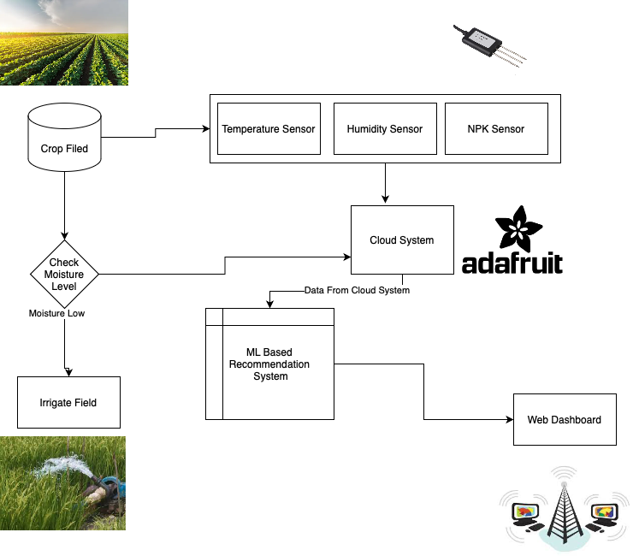



Architecture Diagram

Slide 21
PROPOSED MODULES
Sensor Integration module
Automatic Irrigation module
Nutrient Monitoring and Dosing module
Environmental Monitoring module
Soil/Water pH Monitoring module
Cloud Analytics and Database module
Machine Learning Recommendation System module
User Interface and Accessibility module

Slide 22
PROPOSED MODULES DESCRIPTION
Sensor Integration Module: Provides thorough and up-to-date data gathering for crop monitoring by integrating a variety of sensors, such as environmental, pH, moisture and NPK sensors.
The Automatic Irrigation Module is responsible for implementing the Automatic Irrigation System, which is triggered by moisture sensor readings. It maximizes water use and precisely hydrates crops to promote optimal development.

Slide 23
The Nutrient Monitoring and Dosing module continuously monitors the amounts of nutrients in the soil by using NPK sensors. Adapts nutrient dosage dynamically in response to real-time sensor data, guaranteeing crops receive a customized and balanced supply.
The environmental monitoring module has sensors to track the amount of sunshine, humidity and temperature. allows for the creation of adaptive strategies by giving real-time insights into the environmental factors impacting crop development.

Slide 24
pH sensors are included in the soil/water pH monitoring module to track the acidity or alkalinity of the material. permits in-the-moment monitoring and action to preserve ideal pH levels for efficient nutrition absorption.
The Cloud Analytics and Database Module creates a platform for storing, analyzing and visualizing data on the cloud. gives farmers access to historical and current data, enabling them to make well-informed decisions.

Slide 25
Machine Intelligence Suggestion System Module: Consolidates real-time and historical data analysis using machine learning methods. gives farmers customized advice on the best crop management techniques.
User Interface and Accessibility Module: Creates a user-friendly interface that may be accessed via Cloud Analytics. ensures farmer ease of use by offering capabilities for data visualization, setup options and user-friendly interfaces.

Slide 26
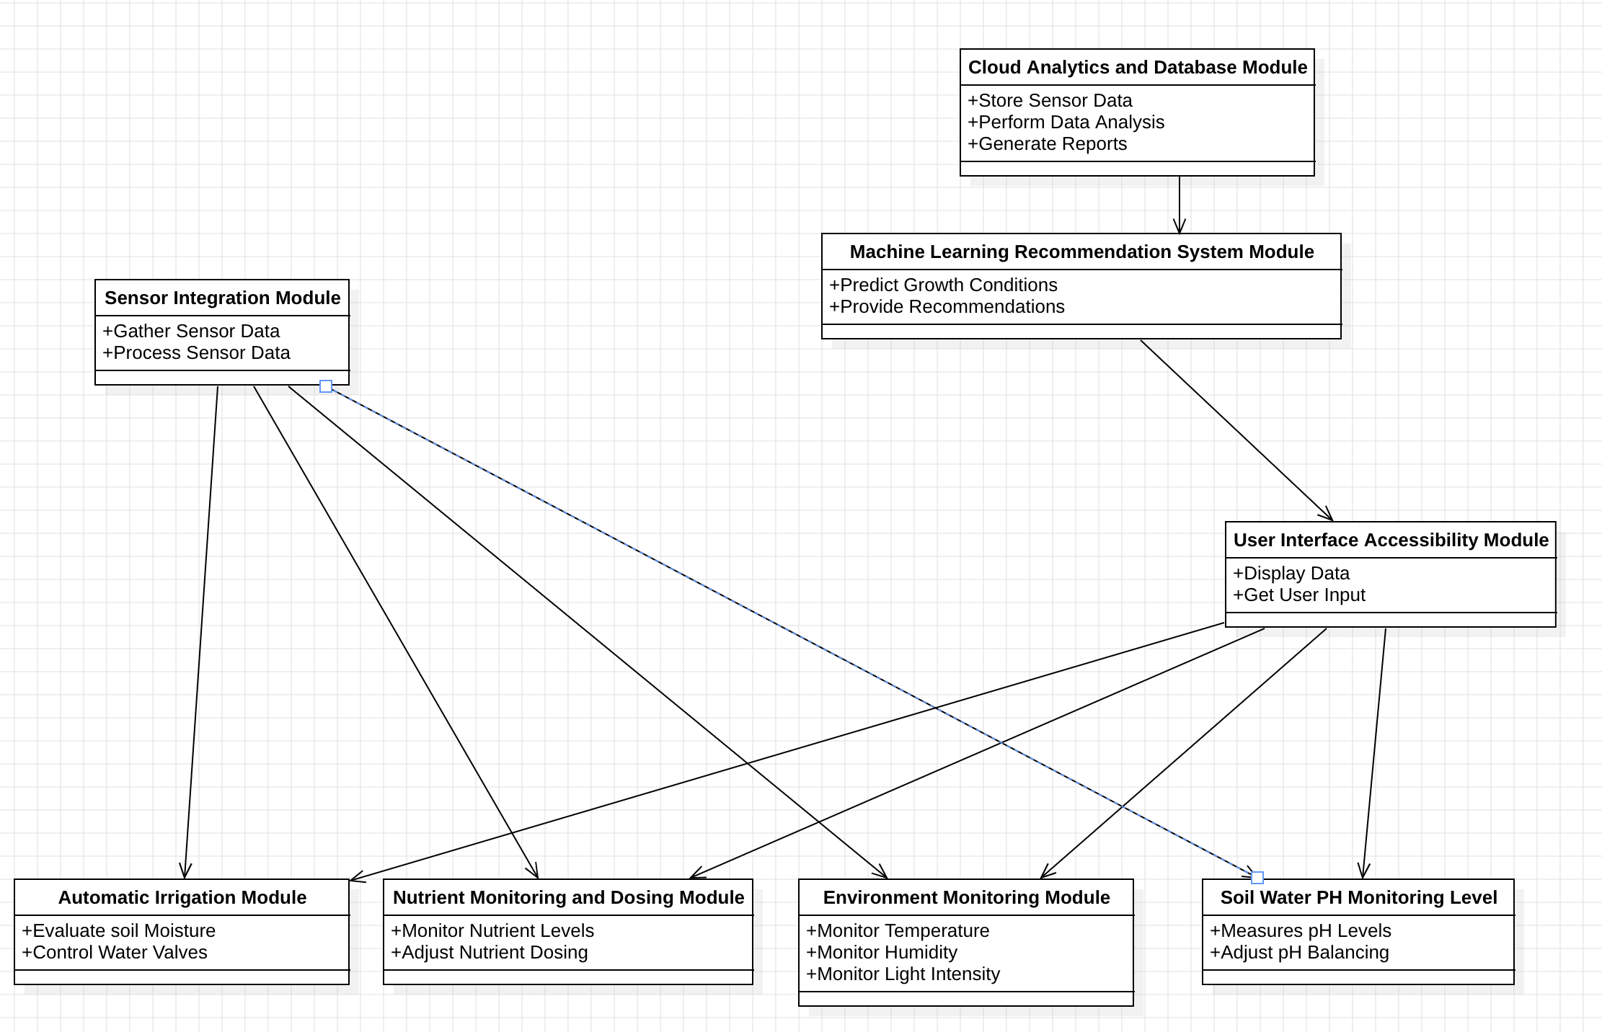
UML Class Diagram

Slide 27
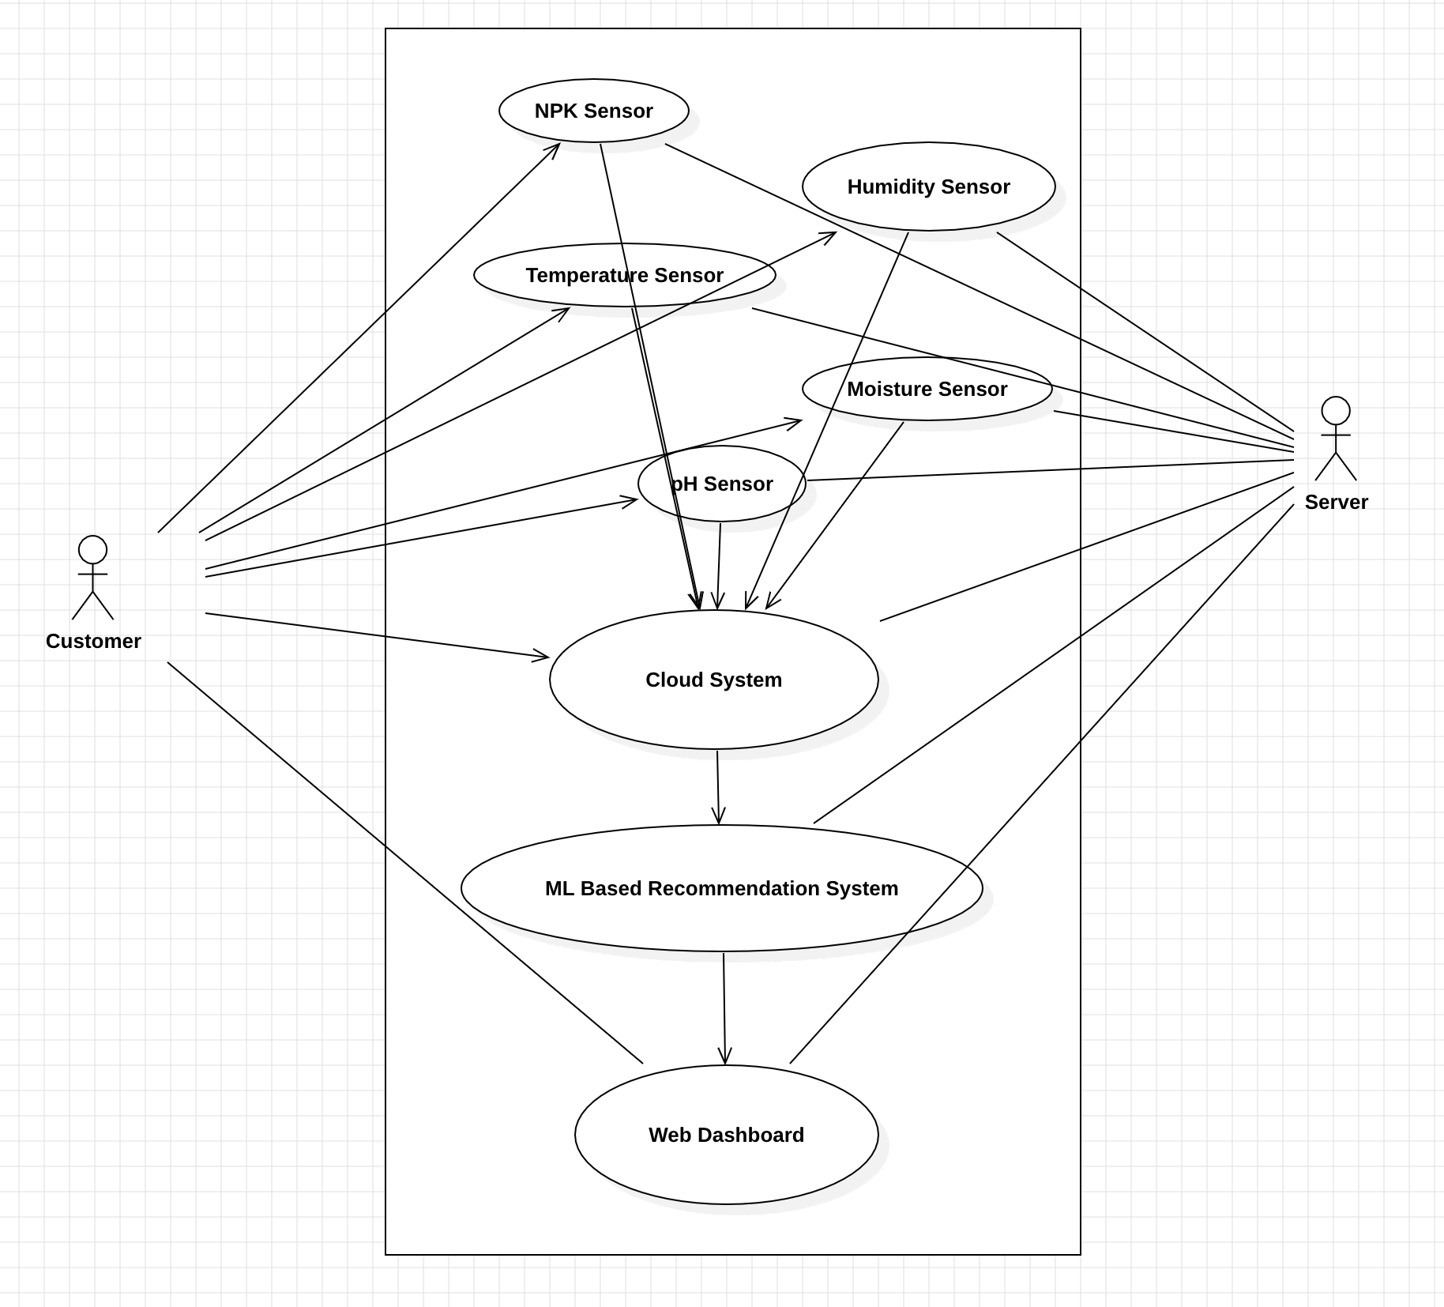
UML Use Case Diagram

Slide 28
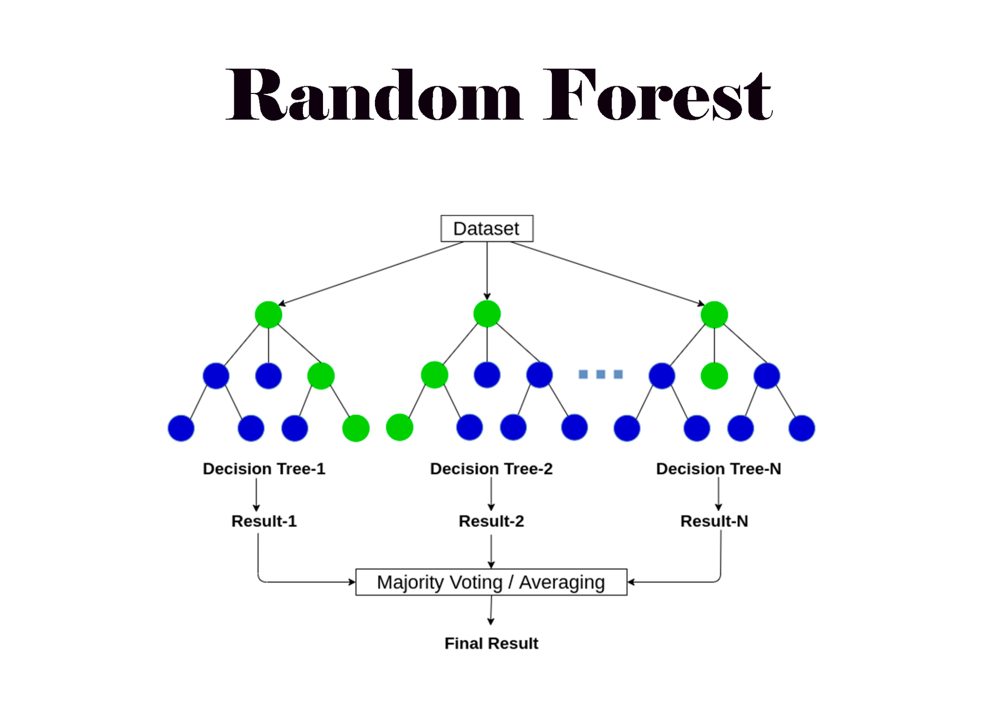
Recommendation System
Algorithm - Random Forest
Random forest is a machine learning algorithm that combines the results of multiple decision trees to produce a single result. It is a supervised learning algorithm that is often used for classification and regression problems.
It helps in getting more stable and accurate results.
This algorithm is scalable and can handle large datasets with high dimensions.
Accuracy of this algorithm is quite high as compared to other algorithms

Slide 29
Why Random Forest?
Random Forest builds multiple decision trees and merges them together to get a more accurate and stable prediction.
It can be used on a random subset of the training data and a random subset of the features
Random Forest | Linear Regression | Decision Trees | SVM | Naive Bayes
Moderate interpretability | High interpretability | High interpretability | Moderate interpretability | Moderate interpretability
Capable of handling non-linearity | Not capable of handling non-linearity | Capable of handling non-linearity | Capable of handling non-linearity | Capable of handling non-linearity
Provides feature importance | Does not provide feature importance | Provides feature importance | Does not provide feature importance | Does not provide feature importance
Moderate scalability | High scalability | Moderate scalability | Moderate scalability | High scalability
Can handle missing values | Cannot handle missing values | Can handle missing values | Cannot handle missing values | Cannot handle missing values

Slide 30
Datasets description
Dataset name - Crop_recommendation
Size - 173KB
Entries- 2201 x 8

Slide 31
Test description
NPK sensor Testing
Objective - Determine the accuracy and reliability of NPK sensors for monitoring nutrient levels in soil and administering fertilizers accordingly.
Automatic irrigation test
Objective - Determine the functioning and effectiveness of the autonomous irrigation system in optimizing water consumption using moisture sensor readings.

Slide 32
pH Sensor test
Objective - To validate the accuracy of pH sensors in monitoring soil pH levels for optimal crop growth.
Recommendation Accuracy
Objective - To provide the most suitable and productive crop recommendation

Slide 33
Implementation
Hardware setup
Collecting sensor
Deploying irrigation system
Calibrating Sensor
Cloud Analytics Setup
Used Adafruit software
Developed interface
Visualize the data
Recommendation System
Collected dataset
Import algorithm
Recommend

Slide 34
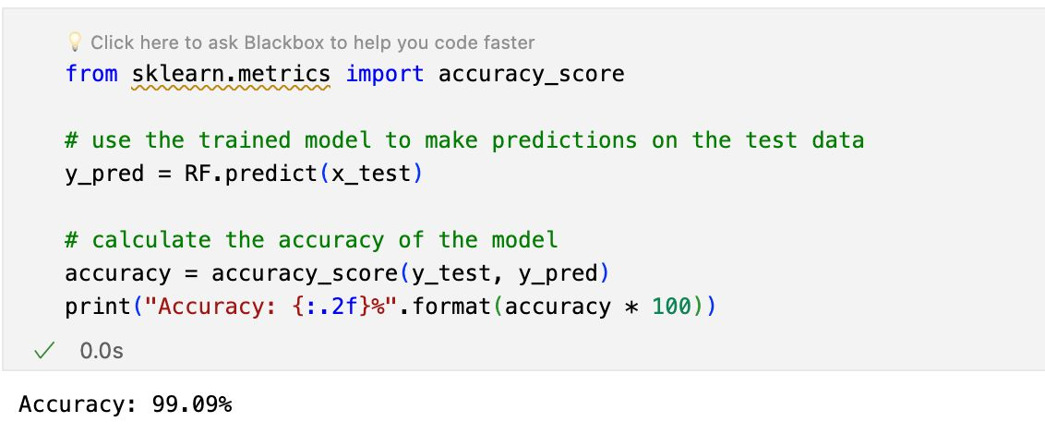
Result & Discussion

Slide 35
Result & Discussions
Model | Accuracy Score | Precision Score | Recall Score | F1 Score | K- Cross Validation Score (k-10)
Random Forest (RF) | 99.09% | 97.37% | 97.19% | 97.60% | 99.45%
KNN | 96.36% | 94.80% | 95.50% | 95.10% | 97.00%
DT | 86.64% | 84.20% | 97.10% | 85.60% | 92.00%
SVM | 97.73% | 88.00% | 86.70% | 87.30% | 88.50%
XGBoost | 95.62% | 96.10% | 95.20% | 95.60% | 96.31%
Logistic Regression | 94.21% | 93.50% | 94.80% | 94.10% | 93.82%

Slide 36
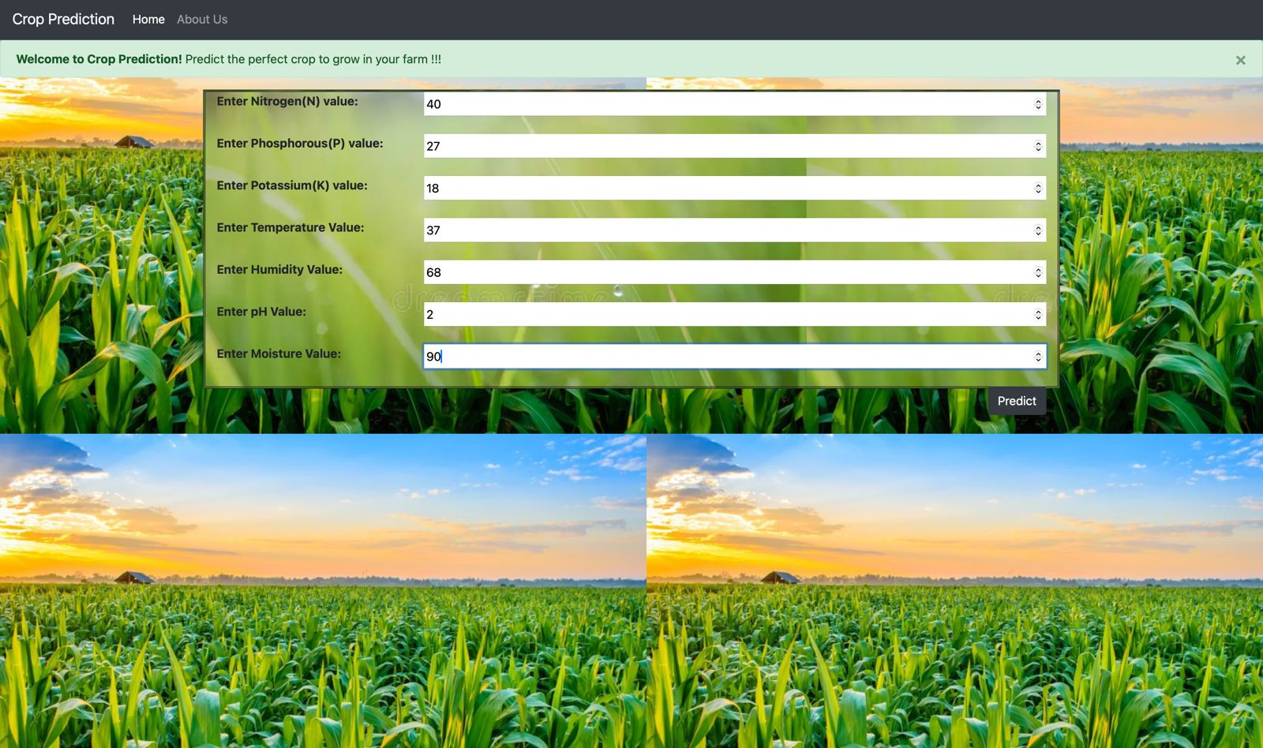
Result & Discussion

Slide 37
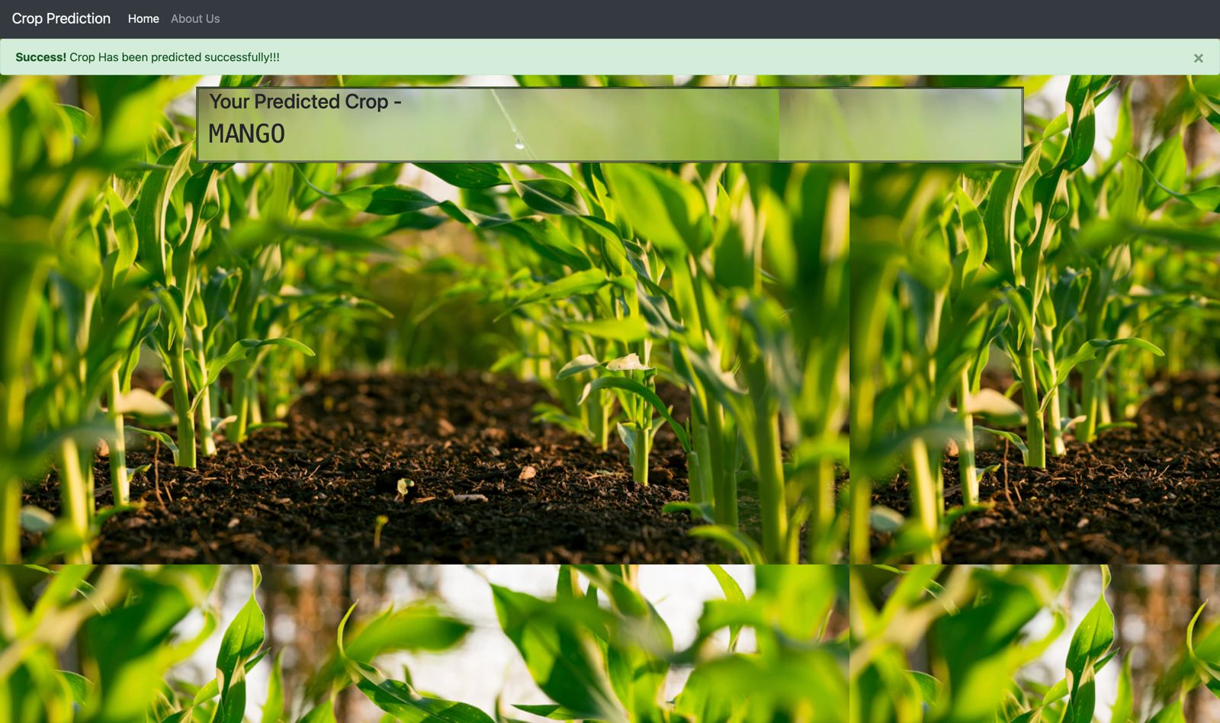

Slide 38
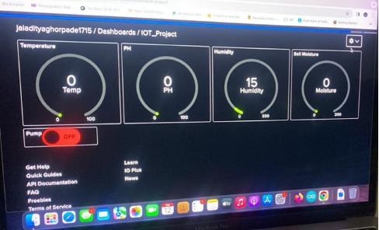

Slide 39
Conclusion
The MCG-RE revolutionizes agriculture, blending sensors, Cloud Analytics and a smart Recommendation System for real-time crop management. From Automatic Irrigation to NPK-powered Nutrient Monitoring, it redefines precision farming. Environmental adaptability and Soil/Water pH Monitoring optimize conditions. The user-friendly Cloud Analytics and machine learning Recommendation System empower farmers. This project not only meets but surpasses global sustainability goals, reshaping farming for efficiency and resilience. The MCG-RE is a beacon guiding agriculture into a sustainable, productive future.

Slide 40
References
Accelerating Crop Yield: Multisensor Data Fusion and Machine Learning for Agriculture Text Classification
WB-CPI: Weather Based Crop Prediction in India Using Big Data Analytics
Internet of Things (IoT) Assisted Context Aware Fertilizer Recommendation
Internet of Things and Wireless Sensor Networks for Smart Agriculture Applications: A Survey
CROPCARE: An Intelligent Real-Time Sustainable IoT System for Crop Disease Detection Using Mobile Vision
An Intelligent Irrigation Scheduling System Using Low-Cost Wireless Sensor Network Toward Sustainable and Precision Agriculture
WaterNet: A Network for Monitoring and Assessing Water Quality for Drinking and Irrigation Purposes
How to Feed a Growing Population—An IoT Approach to Crop Health and Growth
Research on the Evolutionary Decision-Making Behavior Among the Government, Farmers and Consumers: Based on the Quality and Safety of Agricultural Products
How Digital Business Penetration Influences Farmers’ Sense of Economic Gain: The Role of Farmers’ Entrepreneurial Orientation and Market Responsiveness

Slide 41
THANK YOU

